Slide 1


More Bang for Your Buck: Natural Perturbations for Robust QA
Daniel Khashabi Tushar Khot Ashish Sabharwal
Allen Institute for AI Allen Institute for AI Allen Institute for AI
Notes:
Hi everybody!
I am Daniel Khashabi, from Allen Institute for AI and this is a presentation on our EMNLP short-paper: …

Slide 2


Dataset Construction Pipeline
Many NLP models remain data-hungry.
Large & rich datasets
Dataset construction is often implemented as a repeated process of creating new instances by human annotators.
This can be a costly step and bottleneck for building stronger NLP models.
(Yonge Street) The Guinness Book of World Records no longer lists Yonge Street as the longest street in the world and has not chosen a replacement street, but cites the Pan-American Highway as the world's longest “motorable road’”.
Human Annotators
Q: Is the “Yonge Street” the longest street in the world? ✘
Notes:
Many NLP models still require large and rich training datasets, which highlight the importance of exploring alternative ways of building them.
Dataset construction is typically formulated as a repeated task of writing new instances, often done by human annotators.
For instance, if you want to crowdsource natural language questions, one way to do it is to show human-annotators paragraphs of text and based on them, ask them to write questions.
This can be a costly step and potentially a bottleneck to building stronger NLP models.
====
Obviously, this is not the only way to build a QA dataset; but we assume that this is the baseline dataset creation process. As I will argue later, this might not be a vastly limiting assumption to make.

Slide 3
An Alternative Construction
We explore a slightly different dataset construction pipeline:
Creating natural perturbations are easier than writing new questions.
Q: Is the “Yonge Street” the longest street in the world? (ans: ✘)
(Yonge Street) The Guinness Book of World Records no longer lists Yonge Street as the longest street in the world and has not chosen a replacement street, but cites the Pan-American Highway as the world's longest “motorable road’”.
Q: Was the “Yonge Street” the longest street in the world in the past? (ans: ✓)
Q: Was the 'Yonge Street' the longest street in the world before 1980? (ans: unknown)
natural perturbations
!= adversarial perturbations
[Jia & Liang, 2017]
Conjecture: building datasets w/ natural perturbations are more cost-efficient.
Notes:
In this work, we explore a slightly different paradigm for dataset construction; think of an annotation process, where instead of writing new instances, we only apply local perturbations to existing instances:
For example, suppose you’re given a question ….
-> an annotator can make local changes to this question, to make it convey a slightly different meaning.
For instance, here the tense of the question has changed and a temporal attribute has been added.
We call this process: natural-perturbations, since they’re generated by humans and often are diverse and challenging.
This is in contrast to “adversarial perturbations”, which are often machine-based or rule-based, typically to stumble existing machine solvers.
One intuition here is that in creating perturbations is an easier task than writing new instances.
Hence, the conjecture that we explore is that construction via natural perturbations is a more cost-efficient alternative to the traditional way of creating new datasets.
Addressing this conjecture constitutes the majority of the experiments presented in our work.

Slide 4
Perturbing Boolean Questions
Question perturbations
Question Verification
BoolQ [Clark et al, 2019]
BoolQ perturbations collected on Amazon Mechanical Turk
Minimal changes
(2) Often flip the answer
Q: Is the “Yonge Street” the longest street in the world? (ans: ✘)
Q: Was the “Yonge Street” the longest street in the world in the past? (ans: ✓)
Q: Was the 'Yonge Street' the longest street in the world before 1980? (ans: unknown)
Q: Will the “Yonge Street” become the longest street in the world? (ans: ✘)
(Yonge Street) The Guinness Book of World Records no longer lists Yonge Street as the longest street in the world and has not chosen a replacement street, but cites the Pan-American Highway as the world's longest “motorable road’”.
Notes:
To investigate this conjecture, we crowdsource natural perturbations for an existing dataset; namely BoolQ [by Clark et al].
This is done in two steps:
In the first step, crowdworkers are asked to minimally perturb the questions such that
(1) the changes are minimal and
(2) answer labels are different in a good portion of the cases.
2. This is followed by an independent verification step to verify dataset quality.
The result is a collection of perturbed questions for the BoolQ dataset which we will use for our experiments.
====== by ensuring all generated questions are answerable given the relevant paragraph
1. Crowdworkers are given a question and its corresponding gold answer.
For each question, we ask crowdworkers to apply minimal perturbations to the questions such that:
- the changes are minimal and
- that in a good portion of the cases they change the answers to the original questions.
How do you go about comparing these two approaches? [transition from the previous slide]
I.e., if the answer was ”yes”, it’d change to “no” (and vice versa)
The construction should incentivize creativity and diversity in local perturbations by, for instance, showing thought-provoking suggestions, using a diverse pool of annotators

Slide 5


Experimental Setup
Approach A
$
$
writing new instances
perturbing a question
Perturb questions
Approach B
Seed dataset
Intuition: perturbing questions is easier and cheaper than writing a question from scratch
cost-ratio =
perturbing a question
$
$
writing a new question
Notes:
Let’s make our experimental setup more concrete:
Suppose you want to build the best possible dataset, for a fixed amount of budget.
You have [at least] alternatives:
Approach A: Use this money in a pipeline where each instance is written by human worker.
Approach B: Or, use some money to create an initial seed of instances, followed by local perturbations on each instance.
While in approach A all questions are created by a human worker,
in approach B, only a limited set of questions are written (as our seed set) and the rest are perturbed.
And since perturbing questions is often cheaper than writing them, approach B is likely to result in overall more questions.
How much more questions? That depends on the ratio of the cost of … over … .
We call this quantity, perturbation cost-ratio and we’re gonna incorporate this parameter in our experiments.
=====
In approach A, you’re probably going to get more some form of diversity in your data. E.g, diversity In terms of the topics covered by the questions.

Slide 6
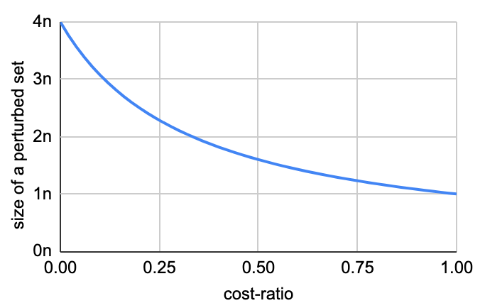
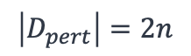
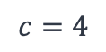
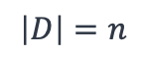
Perturbation Size vs Cost-Ratio
Equivalent-cost datasets, with varying cost-ratio.
BoolQ [Clark et al, 2019]
Approach A
$$\left|D\right|=n$$
size of equivalent-cost dataset when each instance is perturbed 3x
cost-ratio=0.33
Approach B
$$c=4$$
$$\left|D_{pert}\right|=2n$$
BoolQ perturbations
a practical range of
cost-ratio values
Notes:
Suppose you have a construction pipeline that has a cost ratio at 0.33. I.e., each perturbations would cost 1/3 of the cost of writing a new question ground-up.
For a size $n$ subset of data resulted from Approch A (BoolQ, in our experiments), we would like to find an equivalent-cost subset of a dataset resulted from Approach B (i.e., BoolQ perturbations dataset).
With a little bit of calculation, we can see that an equivalent cost Approach B dataset has size 2n, assuming that each instance is perturbed 3 times (i.e., clusters of size four).
To have a more complete picture, here is a plot of equal-cost dataset from Approach B, as a function of cost-ratio.
- for smaller cost-ratios, we get more questions, for the same overall cost.
- And you can see that when cost-ratio is 0.33, the this size 2n.
In reality, the cost-ratio parameter would depend on many factors (the difficulty of the task & quality of the perturbations, etc).
So it’s really a domain and problem dependent variable.
But our intuition is that, for many applications, perturbations are neither too expensive, nor too cheap. Hence, a reasonable value of cost-ratio lies in the middle of the spectrum.
And that's the range that we're interested in.

Slide 7
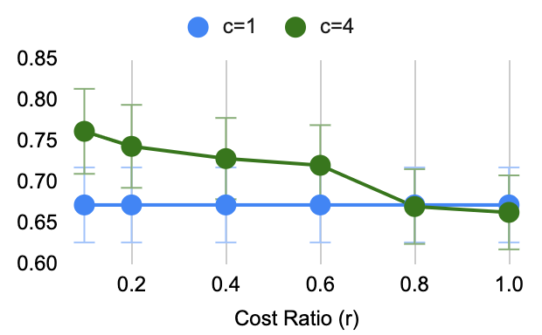
Experiment: Benefits as Function of Cost-Ratio
Evaluations on
BoolQ [Clark et al, 2019]
Approach A (writing new instances) Approach B (each instance perturbed 3x)
Observation:
Moderately cheap perturbations could result in more accurate models.
accuracy
Cost-ratio
Notes:
Let’s see an experiment:
Here we compare the performance of RoBERTa-large model
When trained on data collected from two different approaches:
- In blue, roberta trained on a dataset resulted from Aproach A: as writing new instance
- In green, roberta trained on a dataset of perturbed instances.
Y-axis shows evaluations done on BoolQ test set.
The x-axis indicates cost-ratio, ranging from 0 to 1.0
- When cost ratio is roughly in the middle (a moderately cheap perturbations), we see that trained a model on Approach B data has ~7% gains over the same model trained on Approach A dataset.
- As we keep moving to left, the gains get bigger.
- and when cost-ratio is high, there is no much benefit to to perturbations.
Overall, we see that when natural perturbations are moderately cheap [in the practical range in the middle], they result in more accurate models.

Slide 8
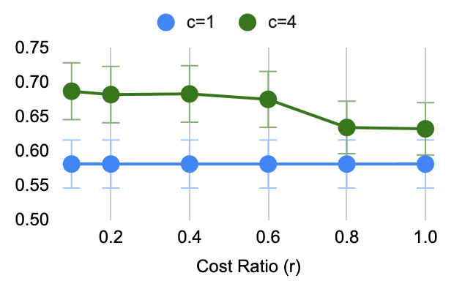
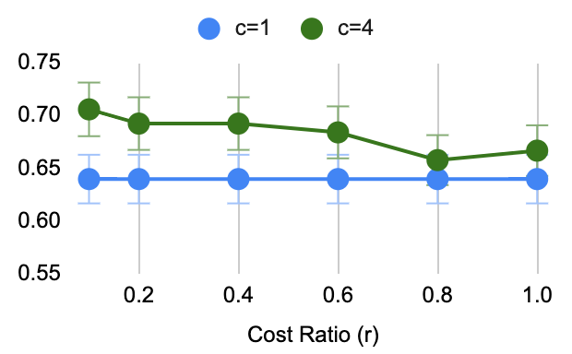
Experiment: Benefits as Function of Cost-Ratio
Approach A (writing new instances) Approach B (each instance perturbed 3x)
Evaluations on
MultiRC [Khashabi et al, 2018]
Evaluations on
Contrast-Set of BoolQ [Gardner et al, 2020]
accuracy
accuracy
Cost-ratio
Cost-ratio
Observation:
Moderately cheap perturbations could result in better generalization to unseen data and and robustness to local perturbations.
Notes:
We repeat the experiment, this time by evaluating the same models on different datasets.
For assessing generalization, we evaluate on the yes/no questions subset of MULTIRC.
For assessing robustness, we evaluate on the contrast set of BoolQ.
We see similar trends:
for a practical range of perturbations cost-ratio, help the model have better generalization and robustness.
We have more experiments in our paper.
======
A related work that will also appear in this year’s EMNLP, in the Finding track.

Slide 9
Recent Work
For reducing spurious associations [Kaushik et al., ICLR, 2020]
NLI task [Huang et al., Workshop on Insights from Negative Results in NLP, 2020]
Do not observe any significant benefits from natural perturbations.
Notes:
Before I end, I would like to highlight two closely related recent works,
Notably, the work by Koushik et al show the value of natural-perturbations in reducing spurious correlations.
And the work by Huang et al. where they study perturbations in the context of textual entailment, where conclude that perturbations were not helpful for generalization in their setup.
========
is by Huang et al, to appear in Workshop on Insights from Negative Results in NLP.
This work conducts similar investigations as to ours, except that they focus on the entailment task and show negative results: they argue that models trained on crowd-sourced perturbations do not generalize better than unaugmented datasets of similar size.
where they study perturbations in the context of textual entailment and do not find perturbations helpful for generalization in their setup.
A different message than that of ours, but it’s good to read both to have a more complete picture.

Slide 10
Summary
An alternative approach for constructing training sets:
Expanding a seed set of examples via human-authored perturbations.
When these perturbations are moderately cheaper, they result in gains.
Better generalization to unseen datasets.
Less sensitive to small changes in the input.
Code & Data: https://github.com/allenai/natural-perturbations
Notes:
To summarize:
We proposed an alternative approach for constructing datasets, by expanding seed examples via natural perturbations. Our results demonstrate that models trained on perturbations of questions are more robust to minor variations and generalize better, if (and this can be a big if) the natural perturbations are moderately cheap to create.
The data used in our experiments for perturbations is available in the following link, in case you’re interested in using them.
Thank you for your attention!
=========
This work suggests a number of interesting lines of future investigation. For instance, how do the results change as a function of the total dataset budget b or large values of c?
Over-generation of perturbations can result in overly-similar (less informative) variations of a seed example, making larger clusters valuable only up to a certain extent.
We find that when natural perturbations are moderately cheaper to create, it is more effective to use them for training models: such models exhibit higher robustness and 4stronger generalization, while retaining performance on the original dataset.

Slide 12
Final Points
Beyond binary QA: do these ideas generalize to other tasks? 🤔
Concurrent works have also explored a similar construction for other tasks:
For example: Kaushik et al. (2020), Gardner et al. (2020)
Related work: [Huang et al, 2020]
NLI task, do not observe any significant benefits from natural perturbations.
Notes:
A key question with respect to the premise of this work is whether the idea would generalize to other tasks.
Here, we chose yes/no questions since this is the least-explored sub-area of QA (compared to extractive QA, for example) and hence could benefit from more efficient dataset construction.
We (the authors) are cautiously optimistic that it would, although that is subject to factors such as the relative cost of creating diverse and challenging perturbations.
Concurrent works have also explored a similar construction for other tasks but with different purposes (Gardner et al., 2020; Kaushik et al., 2020).
A related work interested readers should check out is by Huang et al, to appear in Workshop on Insights from Negative Results in NLP. This work conducts similar investigations as to ours, except that they focus on the entailment task and show negative results: they argue that models trained on crowd-sourced perturbations do not generalize better than unaugmented datasets of similar size.

Slide 13
Recycling BoolQ
BoolQ (Clark et al, 2019)
Human: 89.8% - RoBERTa (single-large): 86.9%
BoolQ
BoolQ ♻

Slide 14
This work: natural perturbations
We explore a slightly different dataset construction pipeline:
Conjecture: building datasets w/ natural perturbations are more cost coefficient.
Seed dataset
Perturbed questions
natural perturbations
!= adversarial perturbations
[Jia & Liang, 2017]
Notes:
Or to show this idea is shown pictorially here:
start from a set of seed examples and then apply human-driven perturbations which often change the gold label as well.
Such construction based on human-driven perturbations which often change the gold label as well.
Left: Seed dataset DS with 3 instances (shown as different shapes).
Right: Expanded dataset D with 10 instances, comprising 2-4 minimal perturbations (illustrated as rotation, fills, etc.) of each seed instance.
We call this process: natural-perturbations, in contrast to “adversarial perturbations”.
Natural perturbations are generated by humans and often are much diverse and challenging.
However, adversarial perturbations are often machine-based or rule-based.
The conjecture that we explore is that construction via natural perturbations is a more cost-efficient alternative to the traditional way of creating new datasets.
Addressing this conjecture constitutes the majority of the experimental work presented in our work.

Slide 15
Experiment: benefits as a function of cost-ratio
Evaluations on
Contrast-Set of BoolQ [Gardner et al, 2020]
Approach A (writing new instances) Approach B (each instance perturbed 3x)
Observation:
Moderately cheap perturbations could result in better robustness to local perturbations.
accuracy
Cost-ratio
Notes:
- When cost ratio is one, there is no much benefit to
For assessing robustness, we use an expert-generated set BOOLQe published in Gardner et al. (2020)
with 339 highquality perturbed questions based on BOOLQ
A paper that will appear in this year’s EMNLP, in the Finding track.
The result on all datasets indicates that there is value in using perturbations clusters when r ≤ 0.6, i.e., larger clusters can be more cost-effective for build better training sets. Even when they are not much cheaper, they retain the same performance as independent examples, making them a good alternative for dataset expansion given few sources of examples (e.g., low resource languages).

